Slide 1
EXERCISE 1
UL expanded its campus, and it was allocated a class B network address, 172.20.0.0, by the ISP. 5 departments: Administrator, Computer Science, Engineering, Library, and Student Labs.
Each department has approx. 25 computers; UL requires that each subnet accommodate at least 30 usable host addresses to allow future expansion. After analyzing the requirements, the admin decides to use the subnet mask 255.255.255.224 (/27). As the engineer, design the subnetting scheme.
Determine the number of subnets that can be created using the given mask.
Determine the number of usable host addresses available in each subnet
Determine the subnet ID, first usable host address, last usable address, and broadcast address for the 5 subnets. Use a table to present your answer

Slide 2
SOLUTION
Fixed number of hosts per subnet 172.20.0.0
255.255.00000000.00000000 /27
2^n = 2^11 = 2048 subnets
Usable host 2^h-2 = 2^5-2 = 30
Subnet | ID | First usable | Last usable | broadcast
0 | 172.20.0.0 | 172.20.0. | 172.20.0. | 172.20.0.
1 | 172.20.0. | 172.20.0. | 172.20.0. | 172.20.0.
2 | 172.20.0. | 172.20.0. | 172.20.0. | 172.20.0.
3 | 172.20.0. | 172.20.0. | 172.20.0. | 172.20.0.
4 | 172.20.0. | 172.20.0. | 172.20.0. | 172.20.0.
5 | 172.20.0. | 172.20.0. | 172.20.0. | 172.20.0.
6 | 172.20.0. | 172.20.0. | 172.20.0. | 172.20.0.

Slide 3
EXAMPLE 2
Campus Network Subnetting (VLSM)
The University of Limpopo is constructing a new academic building to accommodate the increasing number of students and staff. To improve network performance, security, and management, the university's IT department has decided that each department will operate on its own subnet rather than share a single network.
The Internet Service Provider has allocated the network 172.20.0.0/24 for the building. Based on the current requirements and projected growth, the IT department has estimated the maximum number of devices that each department will need to support.
Computer science labs 60, lecture hall 30, admin office 12, and server room 4.

Slide 4
Solution
VLSM 172.20.0.0 /24
Computer science 60 {2^6-2} = 62
172.2 0.0.00000000 / 26
Lecture hall 30 {2^5-2} = 30
172.20.0.00000000 /27
Admin 12 {2^4-2} = 14
172.20.0.00000000 /28
Server room 4 {2^3-2} = 6
172.20.0.00000000 / 29
 | mask | ID | First usable | Last usable | broadcast
/26 | 255.255.255.192 | 172.20.0.0 | 172.20.0.1 | 172.20.0.62 | 172.20.0.63
/27 | 255.255.255.224 | 172.20.0.64 | 172.20.0.65 | 172.20.0.94 | 172.20.0.95
/28 | 255.255.255.240 | 172.20.0.96 | 172.20.0.97 | 172.20.0.110 | 172.20.0.111
/29 | 255.255.255.248 | 172.20.0.112 | 172.20.0.113 | 172.20.0.118 | 172.20.0.119

Slide 5

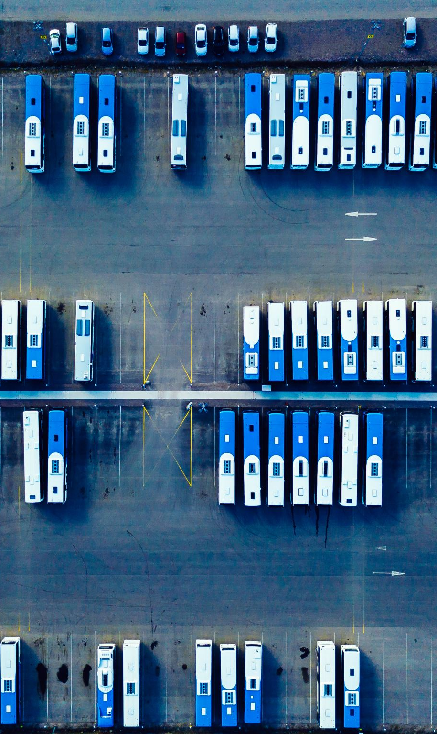
Transport Layer
Notes:
Gray units can be optionally omitted without causing later gaps

Slide 6
Network and Transport Layers
Internet Model
Transport Layer
  Layer 4 in the Internet model
  Links application and network layers
  Responsible for segmentation and reassembly
  Session management
  Responsible for end-to-end delivery of messages
Transport
Network
Data Link
Physical
Application

Slide 7
Transport Layer Protocols
Transmission Control Protocol (TCP)
  Most common transport layer protocol
  Protocol data unit (PDU) is called a segment
  Used for reliable transmission of data
Notes:
TCP ensures that data is delivered reliably, correctly, and in the proper order from the sender to the receiver.

Slide 8
Transport Layer Protocols
User Datagram Protocol (UDP)
  Operates at the transport layer
  PDU called a segment
  Used in time-sensitive situations, for control messages, or when reliability is handled by the application layer
  32-64 bits (4-8 bytes) of overhead
    Source port is optional in IPv4 and IPv6, Checksum is optional in IPv4
Source Port
(16 bits)
Destination Port
(16 bits)
Length
(16 bits)
Checksum
(16 bits)
User Data
(varies)
Notes:
UDP is a protocol designed for fast communication,
The data unit carried by UDP is more precisely called a UDP datagram.
Reliability handled by the application — UDP itself does not retransmit lost data, guarantee delivery, or guarantee ordering. If reliability is required, the application can implement its own mechanisms.

Slide 9
Transport Layer Functions
Linking to the application layer
  TCP/UDP may serve multiple application layer protocols
  Ports used to identify applications (2-byte numbers)
  Many source/destination ports follow standards
  Common port standards
    HTTP: TCP port 80
    HTTPS: TCP port 443
    FTP: TCP ports 20 and 21
    SMTP: TCP port 25
    IMAP: TCP port 143
    POP3: TCP port 110 (more commonly TCP port 995 secure version)
    DNS: TCP or UDP port 53 (most commonly UDP)

Slide 10
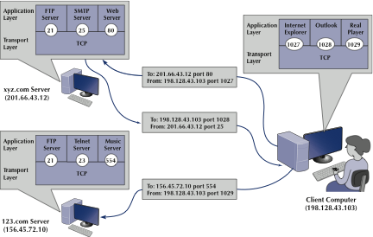
Transport Layer Functions

Slide 11
Transport Layer Functions
Segmenting
  Breaking up large files into smaller segments (and putting them back together)
  Segments may be passed individually to the application layer or after reassembly

Slide 12
Transport Layer Functions
 | Sender | PDU | Receiver
Application |  | Packet
Transport |  | Segment
Network |  | Packet
Data Link |  | Frame
Notes:
Tcp takes the data and adds a tcp header (depending on the protocol used) and it becomes a segment
Network layer takes the segment and adds an IP header and then becomes a packet
The data link layer takes the packet and then add information such as S and D MAC addresses, called frame this is called encapsulation

Slide 13
Transport Layer Functions
Session management
  A session can be thought of as a conversation between two computers or creating a virtual circuit
  Using a session to send data is also called connection-oriented messaging (TCP)
  Sending messages without establishing a session is connectionless messaging (UDP)
  TCP connections are opened using a three-way handshake
    SYN
    SYN-ACK
    ACK
  Sessions provide reliable end-to-end connections

Slide 14
Connection Establishment (1)
Key problem is to ensure reliability even though packets may be lost, corrupted, delayed, and duplicated
  Don’t treat an old or duplicate packet as new
  (Use automatic repeat request (ARQ) and checksums for loss/corruption)
Approach:
  Don’t reuse sequence numbers within twice the MSL (Maximum Segment Lifetime) of 2T=240 secs
  Three-way handshake for establishing a connection
Notes:
It uses checksums to detect corrupted data and ARQ (Automatic Repeat reQuest) to retransmit lost data.
Sequence numbers help TCP identify duplicate or old segments so that they are not mistaken for new data

Slide 15
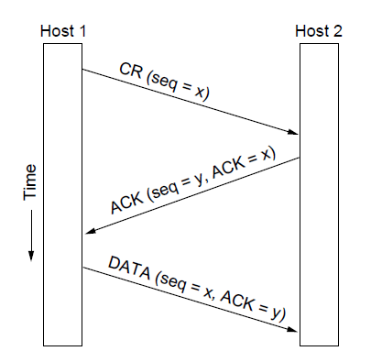
Connection Establishment (2)
Three-way handshake used for initial packet
  Since no state from previous connection
  Both hosts contribute fresh seq. numbers
  CR = Connect Request
Notes:
For the initial packet we can’t tell if it is a duplicate by looking to see if the sequence number has already been received without remembering state across connections, and we don’t want to do that. The 3-way handshake is used instead. Having both hosts contribute fresh sequence numbers (x and y) is key.

Slide 16
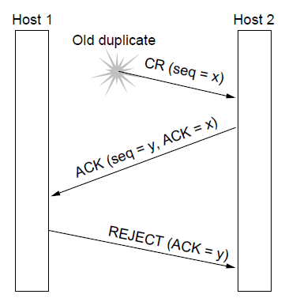
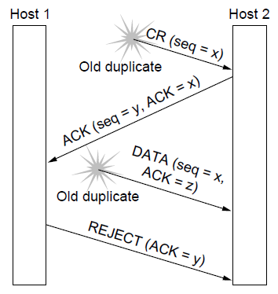
Connection Establishment (3)
Three-way handshake protects against odd cases:
Duplicate Connection Request. Fake ACK does not connect
Duplicate CR and DATA. Same plus DATA will be rejected (wrong ACK).
a)
X
b)
X
X
Notes:
The diagram shows that when an old duplicate connection request (CR) arrives, Host 2 responds, but Host 1 rejects it because the sequence/acknowledgement numbers do not match a current connection. Similarly, if old duplicate data arrives, it is rejected because its acknowledgement information does not correspond to the new connection.

Slide 17
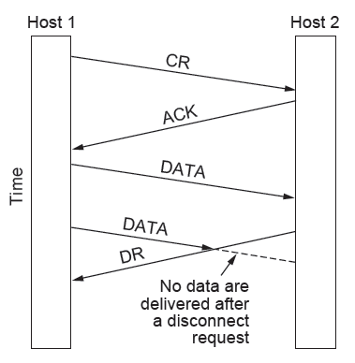
Connection Release (1)
Key problem is to ensure reliability while releasing
Asymmetric release (when one side breaks connection) is abrupt and may lose data
X
Notes:
This diagram shows connection termination: Host 1 first establishes the connection (CR → ACK) and sends data, then Host 2 sends a DR (Disconnect Request) to close the connection. Once the disconnect request has been issued, any data arriving afterward is not delivered, preventing late or delayed data from being treated as valid.

Slide 18
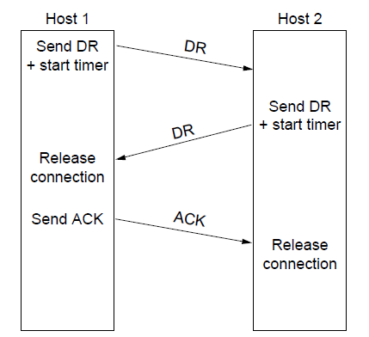
Connection Release (3)
Normal release sequence, initiated by transport user on Host 1
  DR=Disconnect Request
  Both DRs are ACKed by the other side
Notes:
Host 1 sends a DR (Disconnect Request) and starts a timer; Host 2 responds with its own DR, indicating that it is also ready to close. Host 1 then releases its connection and sends an ACK, and when Host 2 receives the ACK, it also releases the connection.

Slide 19
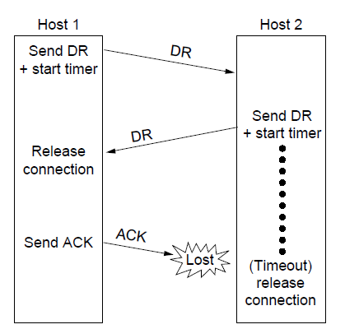
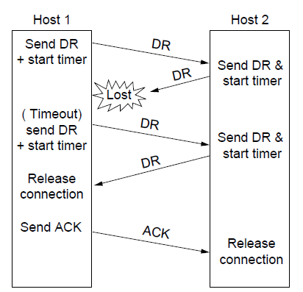
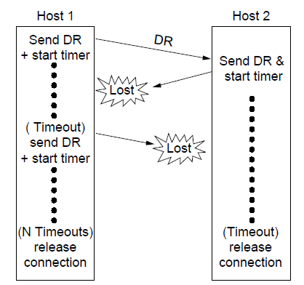
Connection Release (4)
Final ACK lost, Host 2 times out
Lost DR causes retransmissions
Extreme: Many lost DRs cause both hosts to timeout
Notes:
This figure shows what happens when messages are lost while two hosts are trying to disconnect. The timer prevents either host from waiting forever.
Left: Host 1 and Host 2 exchange their DRs successfully, but the final ACK is lost. Host 2 waits for its timer to expire and then releases the connection anyway.
Middle: Host 2's first DR is lost. Host 1 waits, times out, and sends the DR again; this time Host 2 responds, the ACK is received, and both sides close normally.
Right: Communication is badly disrupted—multiple DR messages are lost. After waiting and retrying a specified number of times (N timeouts), Host 1 gives up and releases the connection; Host 2 also eventually times out and releases it.

Slide 20

Friday, 28 August

Slide 21
Error Control and Flow Control (1)
Foundation for error control is a sliding window (from Link layer) with checksums and retransmissions
Flow control manages buffering at sender/receiver
  Issue is that data goes to/from the network and applications at different times
  Window tells sender available buffering at receiver
  Makes a variable-size sliding window (increase /decrease depending on how much buffer space the receiver has
Notes:
Error control ensures that data that is lost or corrupted during transmission is detected and retransmitted,
while flow control ensures that the sender does not send data faster than the receiver can process it.
Checksum – value calculated from the data before sending & check again when it arrives

Slide 22
Congestion Control
Two layers are responsible for congestion control:
    Transport layer, controls the offered load [here]
    Network layer, experiences congestion [previous]
  Three main issues involved in congestion control
  Desirable bandwidth allocation »
  Network should distribute available bandwidth fairly & efficient among users
  Regulating the sending rate »
  Adjust how fast it sends data so that it does not overload the network
  Wireless issues »
  Wireless networks may lose packets due to transmission errors, that packet should not always interpreted as network congestion.
Notes:
The transport layer helps prevent congestion by controlling how much data the sender puts into the network
network layer is where the congestion actually occurs when too much data is travelling through the network.
transport layer controls how many cars enter the road,
network layer is the road that becomes congested when there are too many cars

Slide 23
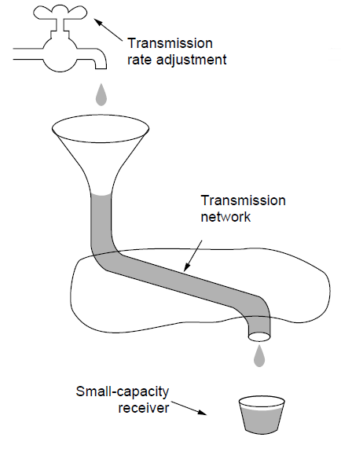
Regulating the Sending Rate (1)
The sender may need to slow down for different reasons:
  Flow control, when the receiver is not fast enough [right]
  Congestion, when the network is not fast enough [over]
A fast network feeding a low-capacity receiver → flow control is needed

Slide 24
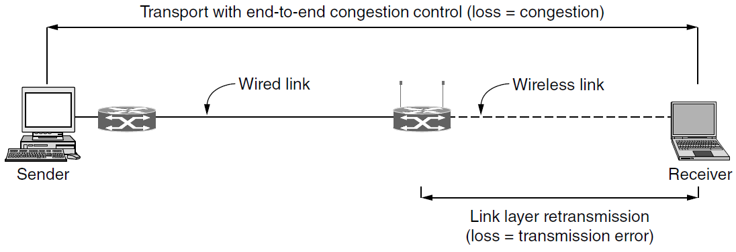
Wireless Issues
Wireless links lose packets due to transmission errors
  Do not want to confuse this loss with congestion
  Or the connection will run slowly over wireless links!
Strategy:
  Wireless links use ARQ, which masks errors
  Packet loss in wireless should not be treated as congestion
Notes:
ARQ – automatic repeat request
From the sender to the receiver, TCP may assume that a lost packet means the network is congested and therefore reduce its sending rate.
However, on the wireless part of the connection, a packet may be lost simply because of transmission errors, such as interference or a weak signal, rather than congestion

Slide 25
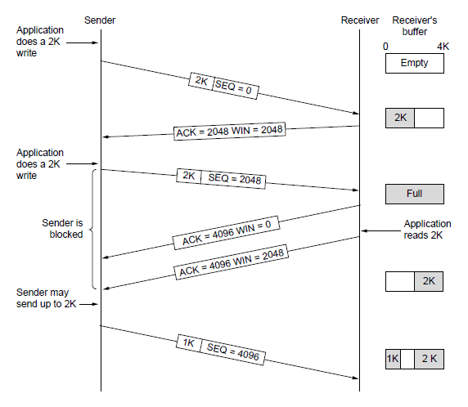
TCP Sliding Window (1)
TCP adds flow control to the sliding window as before
  ACK + WIN is the sender’s limit

Slide 26
Performance Issues
Many strategies for getting good performance have been learned over time
  Performance problems »
    Congestion, too many small packets, excessive traffic
  Measuring network performance »
    Throughput, delay, response time
  Host design for fast networks »
    Designing the S/R so they can process data fast to take advantage of high-speed networks
  Fast segment processing »
    Incoming & outgoing segments quickly to reduce delays
  Header compression »
    Reduce packet/segment headers to use less bandwidth
  Protocols for “long fat” networks »
    Designed to work efficiently on network that have high bandwidth but also long delays such as long-distance high speed links
Notes:
less bandwidth is spent on control information and more can be used for actual data.

Slide 27
Performance Problems
Unexpected loads often interact with protocols to cause performance problems
  Need to find the situations and improve the protocols
Examples:
  Broadcast storm: one broadcast triggers another
  Synchronization: a group of computers all contact the DHCP server together after a power failure (for IP addresses)
  Tiny packets: some situations can cause TCP to send many small packets instead of a few large ones.
Notes:
One broadcast message causes other devices to generate more broadcasts, resulting in a very large amount of traffic that can overwhelm the network
Imagine 500 students trying to enter my office at exactly the same time—the office may normally handle students perfectly well, but the sudden simultaneous demand creates a problem

Slide 28
APPLICATION LAYER

Slide 29
Name servers
Finding the IP address for a given hostname is called resolution and is done with the DNS protocol.
Resolution:
  Computer requests local name server to resolve
  Local name server asks the root name server
  Root returns the name server for a lower zone
  Continue down zones until name server can answer
DNS protocol:
  Runs on UDP port 53, retransmits lost messages
  Caches name server answers for better performance

Slide 30
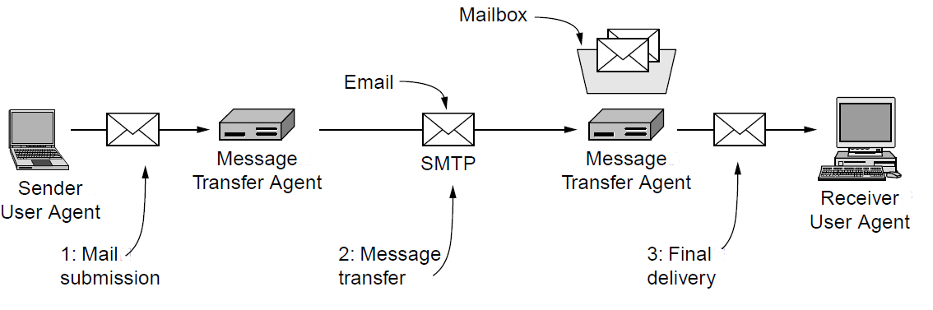
Architecture & services
The key components and steps (numbered) to send email
Architecture of the email system

Slide 31
The WWW
  Architectural overview »
  Static Web pages »
  Dynamic pages and Web applications »
  HTTP – HyperText Transfer Protocol »
  The mobile Web »
  Web search »

Slide 32
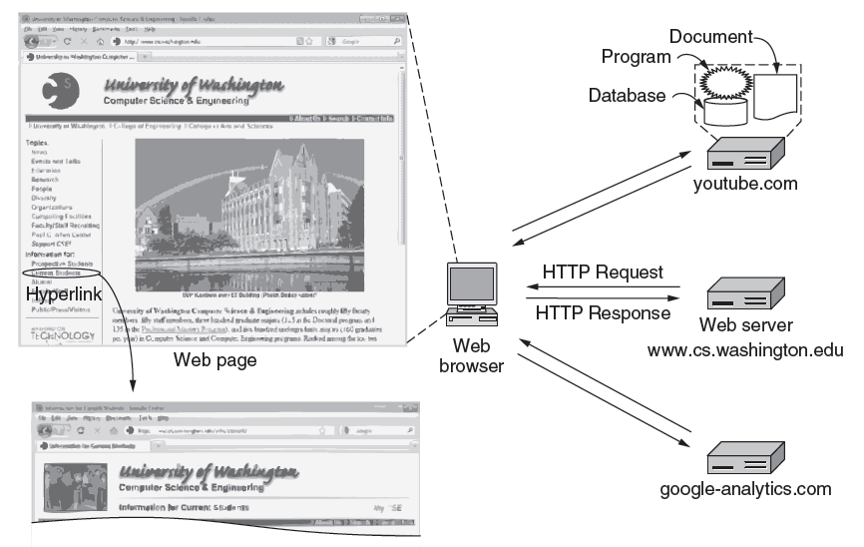
Architectural overview
Notes:
HTTP transfers pages from servers to browsers

Slide 33
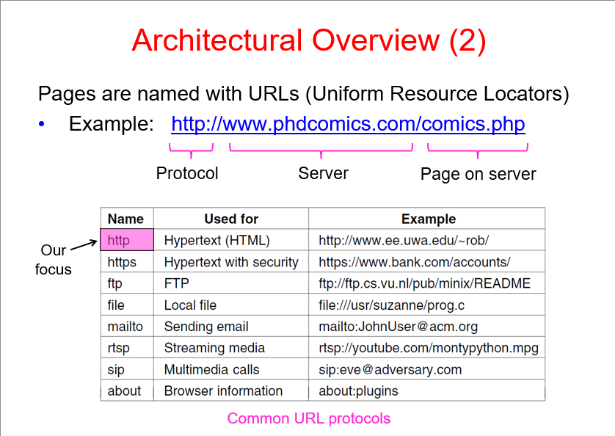

Slide 34
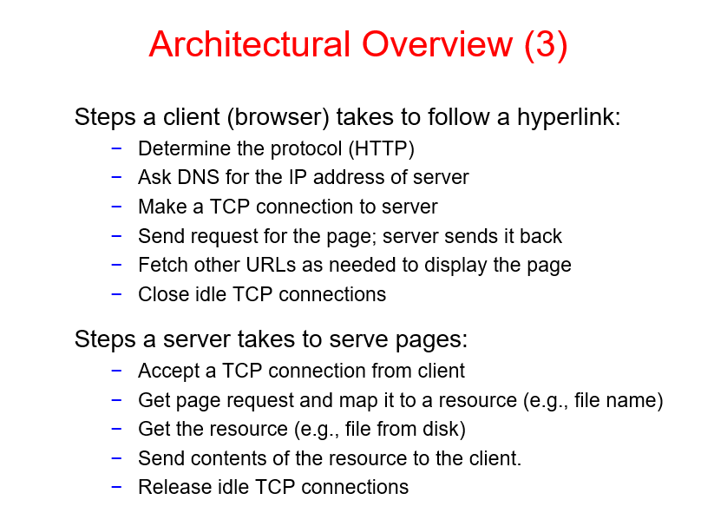

Slide 35
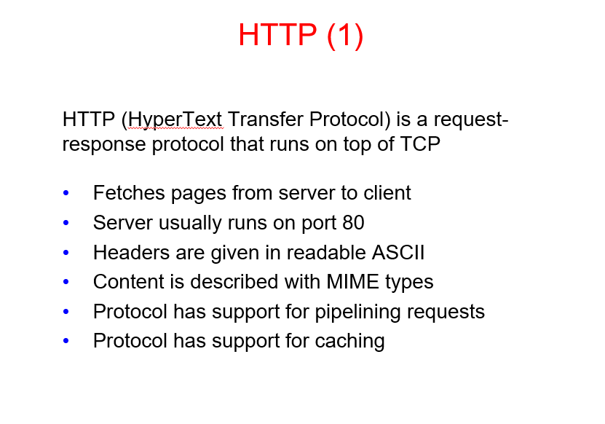

Slide 36
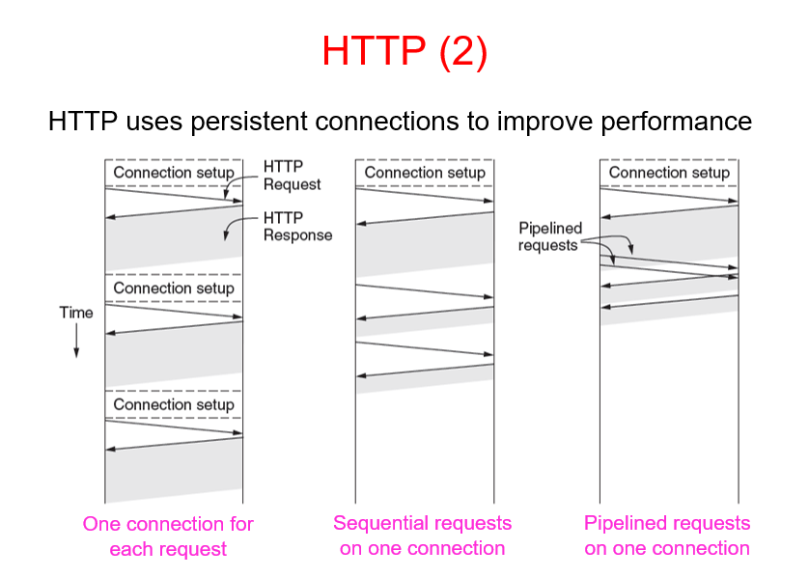
Notes:
One connection for each request
Problem: repeatedly setting up connections wastes time.
2. Sequential requests on one connection
Improvement: there is no need to establish a new connection for every request.
3. Pipelined requests on one connection
Benefit: this reduces waiting time further.

Slide 37
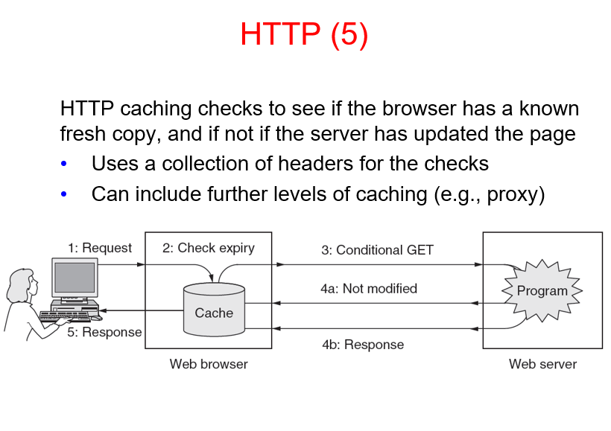

Slide 38
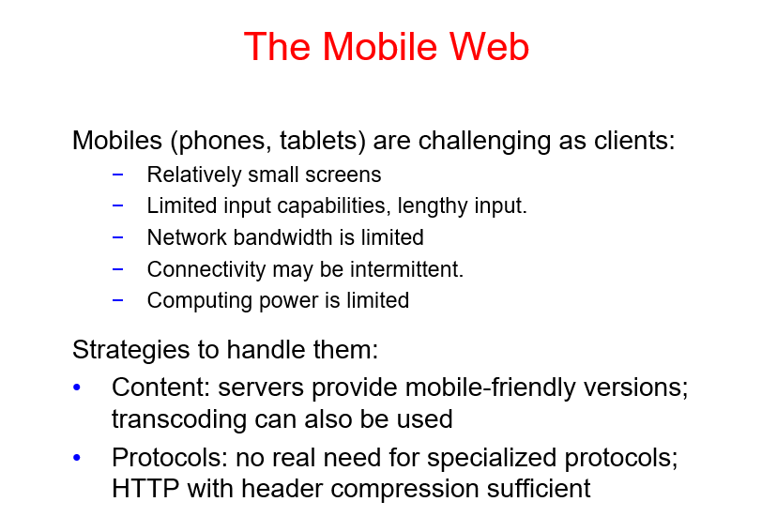
Notes:
Intermittent means something that happens occasionally or repeatedly but not continuously.

Slide 39
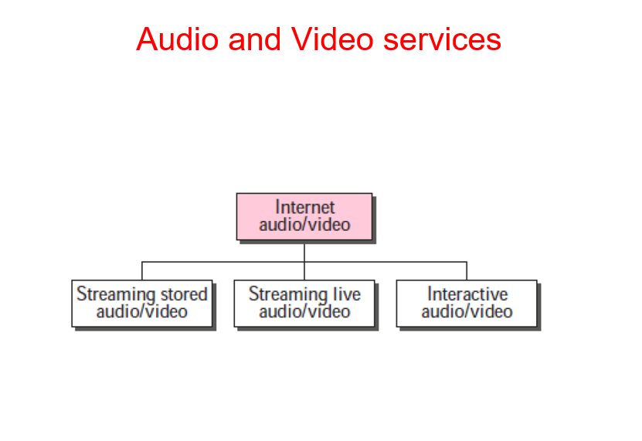

Slide 40
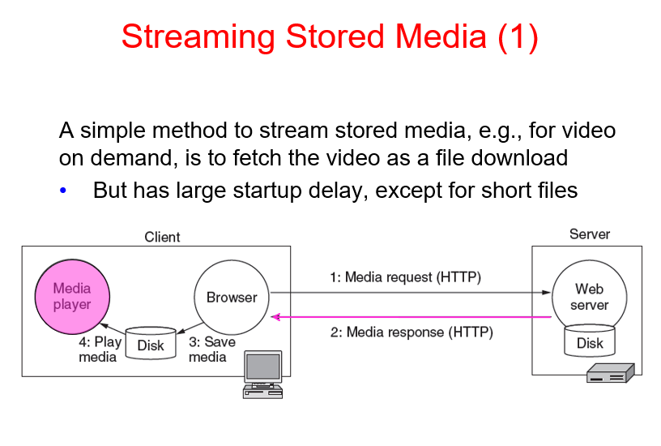

Slide 41
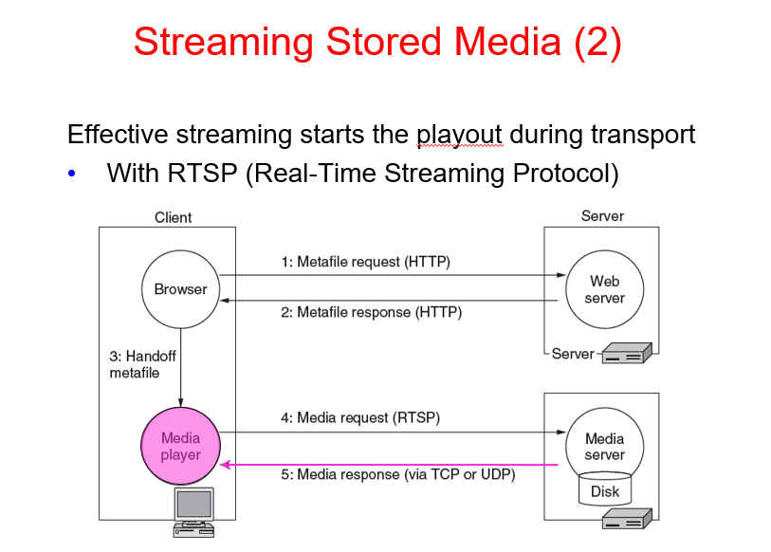

Slide 42
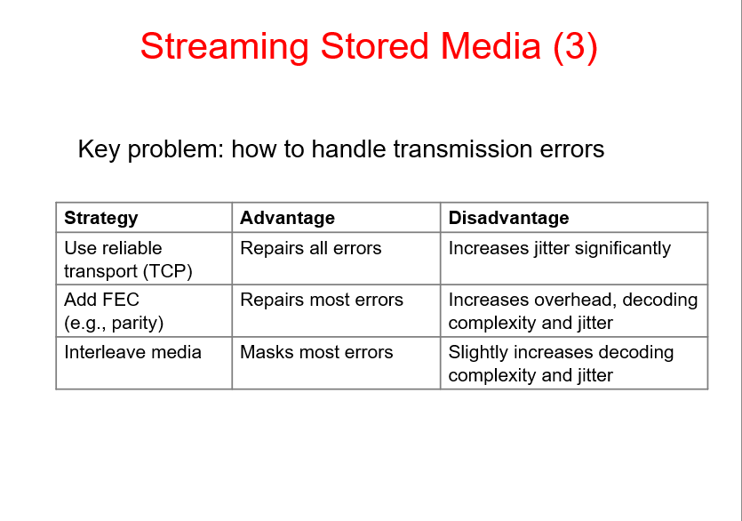
Notes:
Forward Error Correction

Slide 43
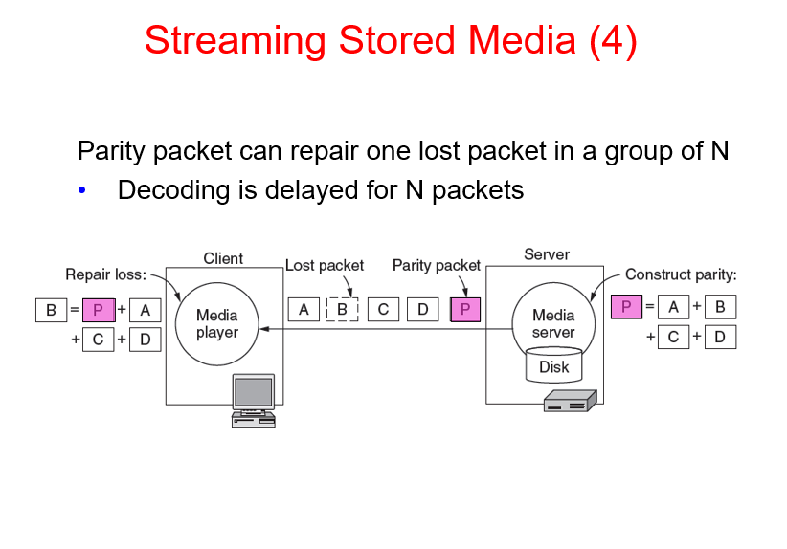

Slide 44
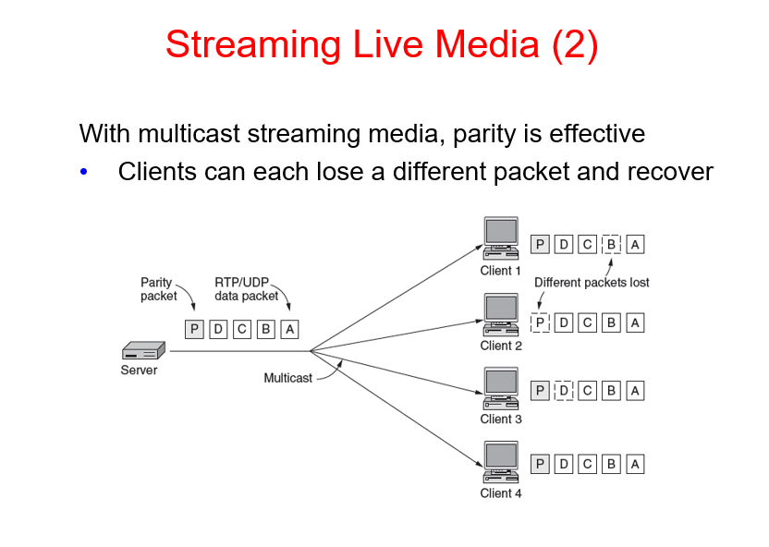

Slide 45
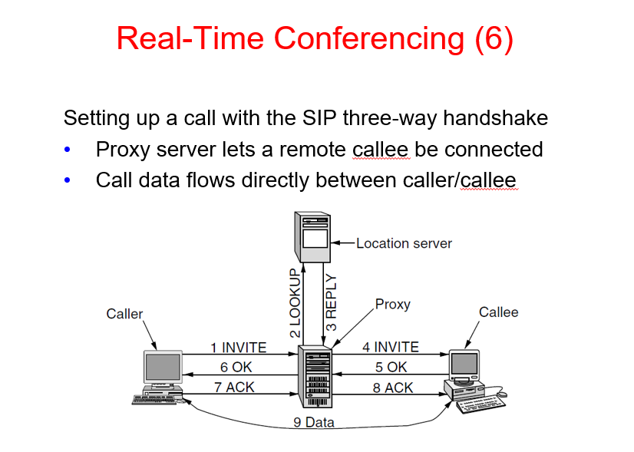
Notes:
Session Initiation Protocol

Slide 46

End

